Slide 1

Protect Your Digital Life: A Comprehensive Guide
Navigate the modern digital landscape safely. Learn risks and solutions to protect your personal data.

Slide 2
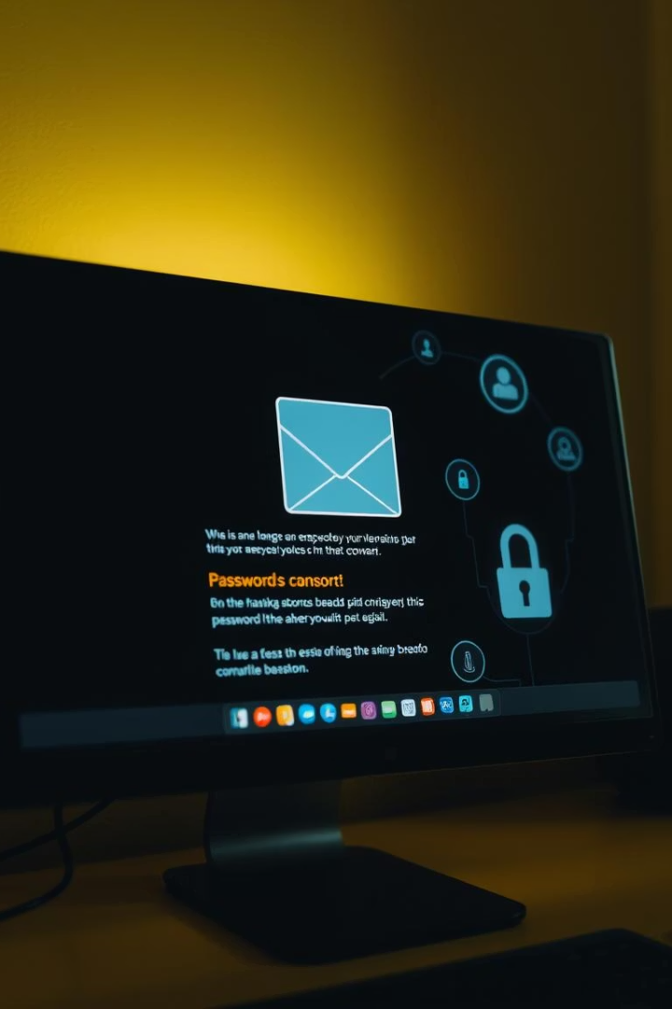
Common Cyber Threats
Phishing Attacks
Malware Infections
60% of breaches involve phishing (Verizon DBIR 2023).
Ransomware costs expected to hit $30B by 2023.
Password Breaches
81% of breaches use weak or stolen passwords.

Slide 3
Data Recovery Risks
Selling Storage Devices
Improper Device Recycling
Public Computer Use
Simply deleting files or formatting a memory card doesn't erase data permanently—special tools can recover it. This can lead to leakage of personal photos, documents, or passwords.
Old phones, USBs, or hard drives given for repair or recycling without secure wiping can be recovered by others, exposing sensitive data like bank details or ID copies.
Saving files temporarily on shared or public PCs (and later deleting them) can still leave traces. Other users might recover those files and access private data.

Slide 4
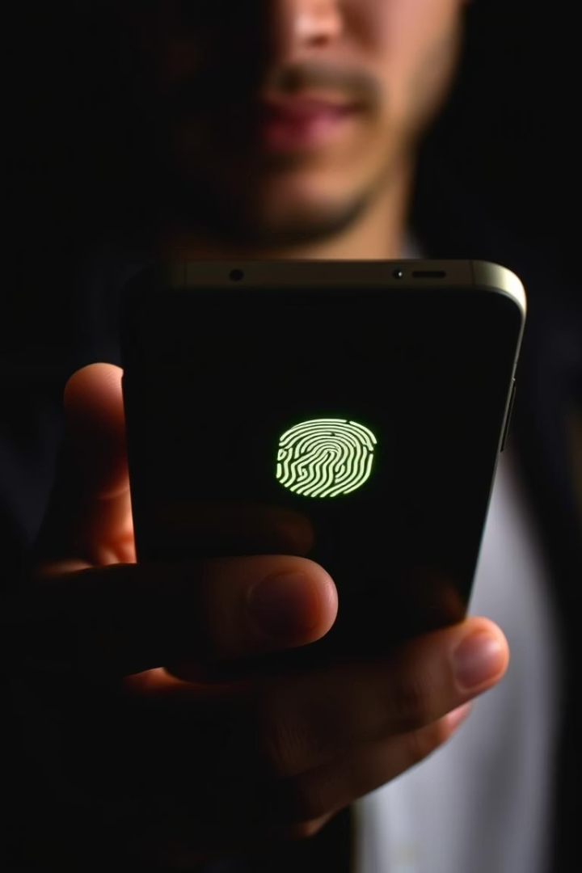



SIM Card & Fingerprint Fraud
SIM Swapping
Fingerprint Spoofing
$68M+ lost in 2022 due to SIM swap fraud.
80% success rate using simple materials.
Biometric Vulnerabilities
30% of biometric systems can be bypassed easily.

Slide 5
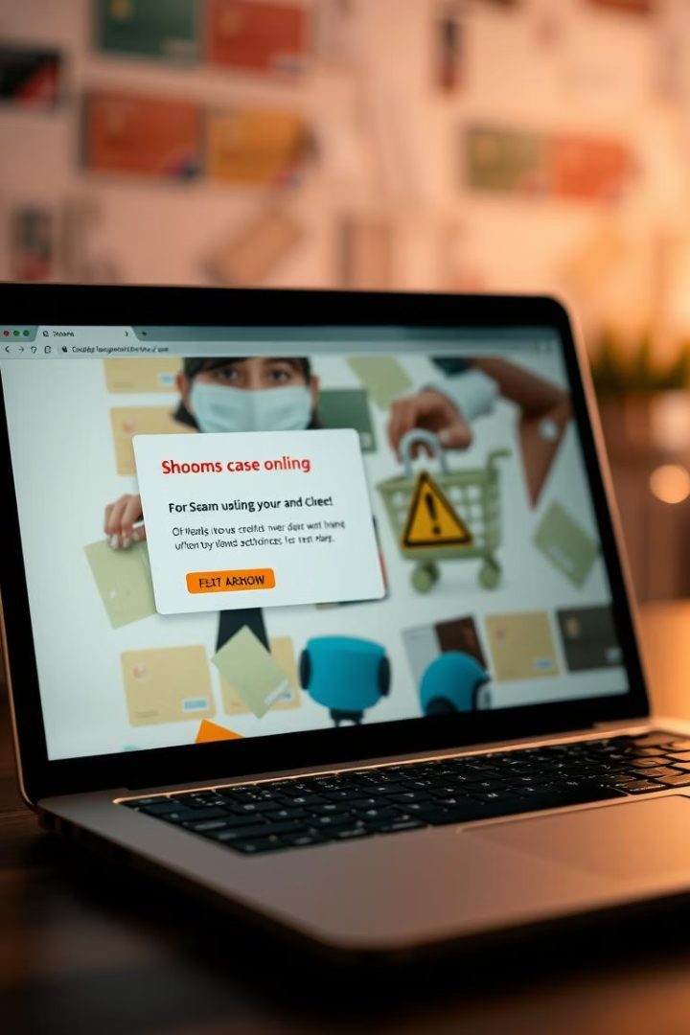
Online Shopping Scams & Carding
E-Commerce Fraud
Carding Attacks
$41B lost globally to online shopping scams in 2022.
Average fraud loss per incident: $185.
Fake Websites
Estimated 25% of online stores are fraudulent.

Slide 6



Mobile & App Safety
App Permissions
2
60% request unnecessary access.
Malicious Apps
3% contain malware or unwanted software.
1
Mobile Phishing
3
Click rates on mobile are 3x higher than desktop.

Slide 7

Your Digital Footprint
Data Brokers
Collect 5,000+ data points per person
Social Media Risks
70% of employers check profiles
Data Permanence
Once online, data is nearly impossible to erase

Slide 8
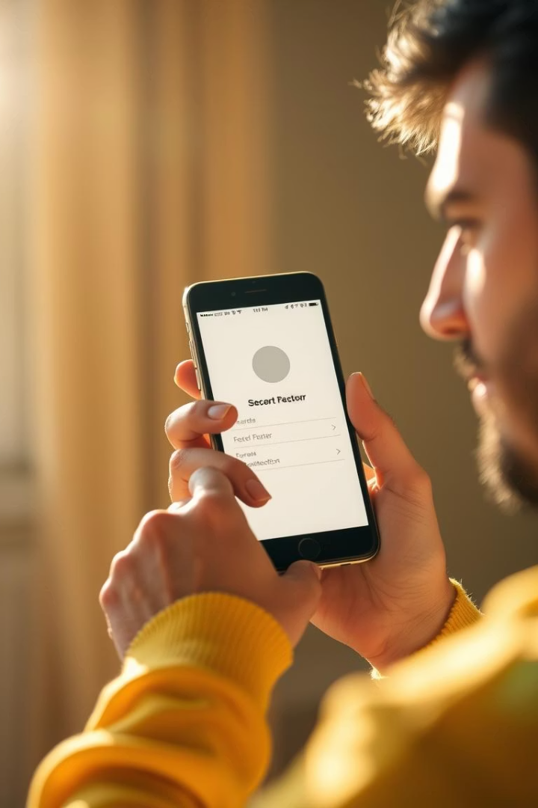
Essential Protection Tips
Strong Passwords
Use unique, complex passwords with 12+ characters.
Two-Factor Authentication
Blocks 99% of automated attacks effectively.
Software Updates
Patch vulnerabilities; 40% of breaches due to unpatched flaws.
Regular Backups
Follow 3-2-1 rule: 3 copies, 2 media types, 1 offsite.

Slide 9




Advanced Threats
Zero-Day Exploits
Cost companies $1M+ per incident on average.
AI-Driven Attacks
Expected to increase by 500% in the coming year.
Deepfakes
Used in 96% of social engineering attacks.

Slide 10

Q&A
Address Your Concerns

